Slide 1
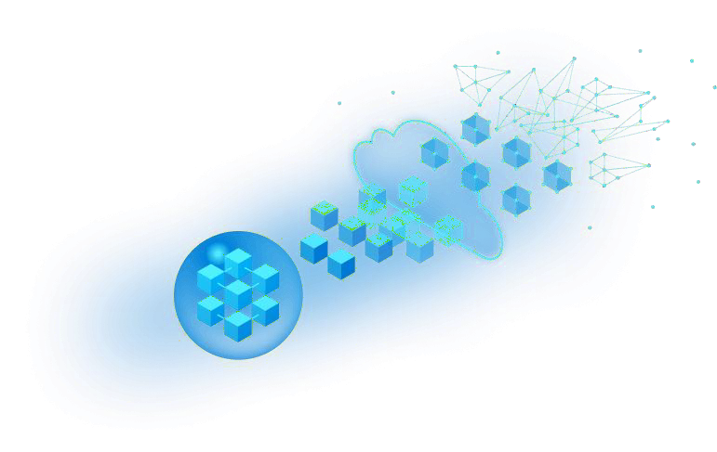

Unlashing the Power of Generative AI In Azure

Slide 2





MCT Summit Sponsor

Slide 3













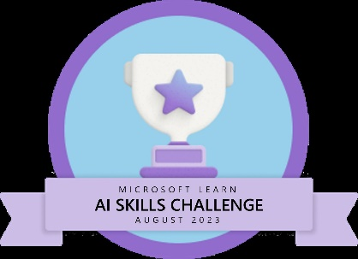

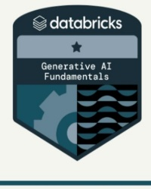


Usama Wahab Khan
Father, data Scientist, Developer/Nerd, Traveler
Twitter : @usamawahabkhan
LinkedIn : Usamawahabkhan

Slide 4


Today’s Opportunity – Your Opportunity

Slide 5
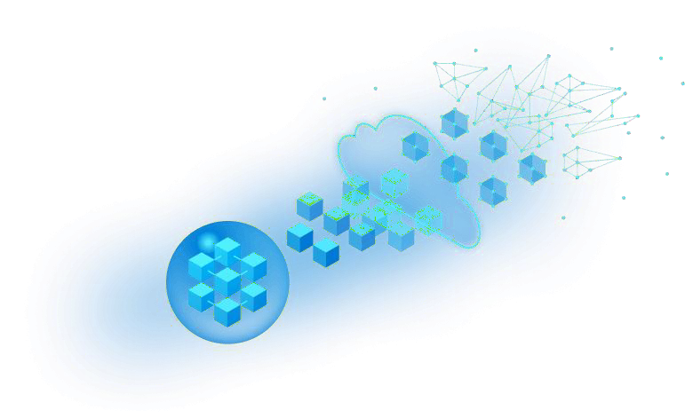
Introduction to AI

Slide 6
Agenda
Introduction to AI
Current State of AI
Types of AI
Popular AI Tools
Azure OpenAI Service Overview
Responsible AI
Why OAI vs. AOAI
Uses and Capabilities
Demo

Slide 7
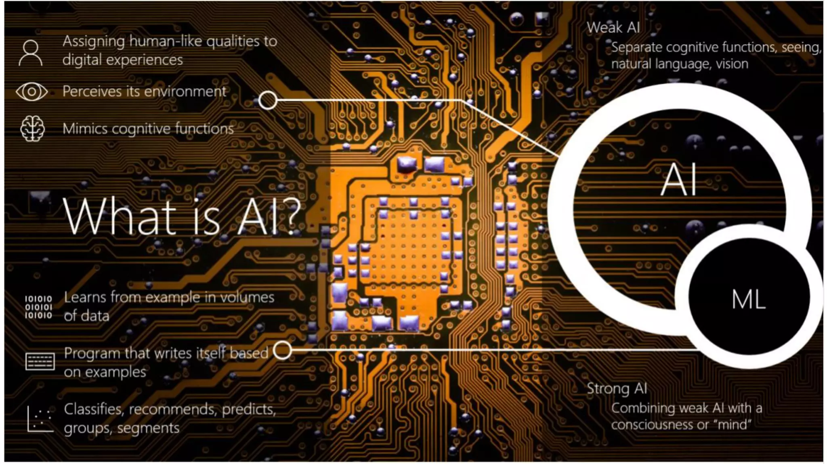
Introduction to AI

Slide 8
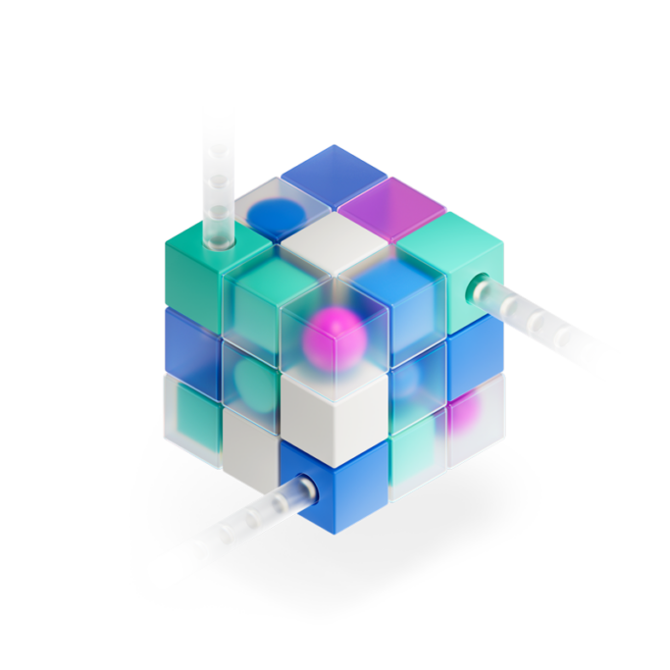
Artificial Intelligence, What is it?
What is AI?
Simply put, AI is the creation of software that imitates human behaviors and capabilities. Key workloads include:
Machine learning - This is often the foundation for an AI system, and is the way we "teach" a computer model to make predictions and draw conclusions from data.
Anomaly detection - The capability to automatically detect errors or unusual activity in a system.
Computer vision - The capability of software to interpret the world visually through cameras, video, and images.
Natural language processing - The capability for a computer to interpret written or spoken language, and respond in kind.
Knowledge mining - The capability to extract information from large volumes of often unstructured data to create a searchable knowledge store.

Slide 9
Types of AI
While there are various forms of AI as it’s a broad concept, we can divide it into the following three categories based on AI’s capabilities:
Weak AI(Narrow intelligence), which is also referred to as Narrow AI, focuses on one task. There is no self-awareness or genuine intelligence in case of a weak AI.
iOS Siri is a good example of a weak AI combining several weak AI techniques to function. It can do a lot of things for the user, and you’ll see how “narrow” it exactly is when you try having conversations with the virtual assistant.
Strong AI (General intelligence ), which is also referred to as True AI, is a computer that is as smart as the human brain. This sort of AI will be able to perform all tasks that a human could do. There is a lot of research going on in this field, but we still have much to do. You should be imagining Matrix or I, Robot here.
Artificial superintelligence , Artificial superintelligence (ASI) is a form of AI that is capable of surpassing human intelligence by manifesting cognitive skills and developing thinking skills of its own.

Slide 10
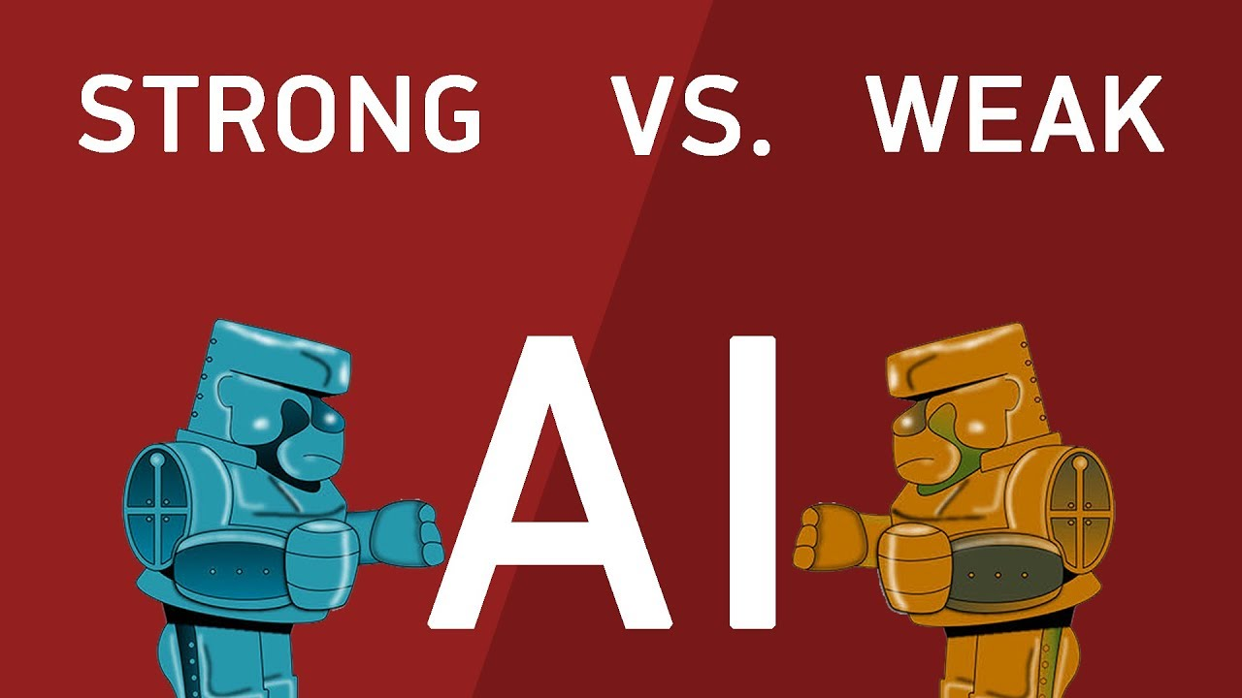
Weak AI is AI that is confined to a narrow task, like when a system processes language into text or sorts all the pictures on your pc.
Examples of Weak AI include: Siri, Cortana, Bing, Netflix, and even ChatGPT
Strong AI is AI that acts exactly as a human would, think C-3PO, the Terminator or Commander Data. They exhibit emotions, real creativity, and can even have a sense of purpose.

Slide 11





Artificial Intelligence
1956
Machine Learning
1997
Deep Learning
2017
Generative AI
2021

Slide 12
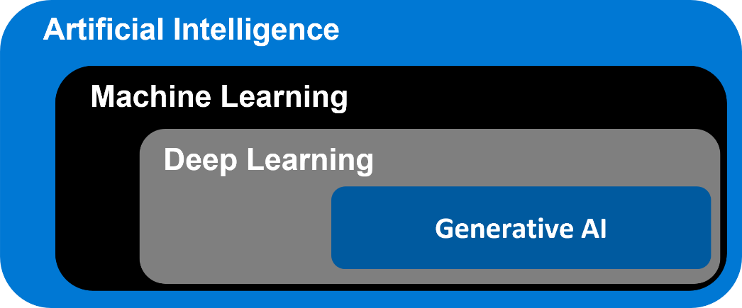
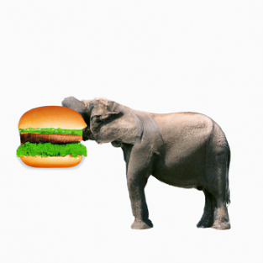
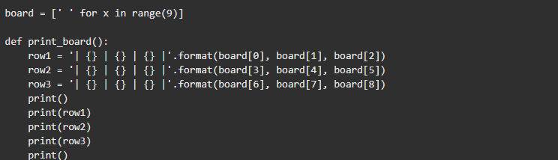
Introduction to Generative AI
Generative AI refers to a type of artificial intelligence that has the ability to generate content that is, in many cases, indistinguishable from content created by humans. This AI can produce text, images, audio, or even video, often in response to a given input or prompt.
Generative AI operates by learning patterns and structures from large datasets and then using that knowledge to produce new content that fits within those learned patterns. It's a type of machine learning where the AI model learns to understand and mimic the characteristics of the data it has been trained on.
Image or Video generation
Code generation

Slide 13
Generative AI capabilities
Creative Ideation
Subject Research
Extracting insights
Dialog agents
Essay outlines
Comments from code
Limitless generation with a few lines of input
Summarizing text
Semantic search
Classifying text
Code generation
Answering questions
Virtual Assistants
Image Generation
Language Translation
Poem creation
Code refactoring
Writing assistance
Notes:
Overview of generative AI capabilities for inspiration.

Slide 14
Why AI? – Why Now?
$1.2
Trillion
“Market for AI” by 2020 —Forrester
“AI is going to shape all of that we do.”
- Satya Nadella
Big Data
Incredible amounts of data are being generated every second, across every business and connected consumer device
Massive Compute Power
Availability of massive & specialized compute resources (especially on the cloud) to process big data with specialized algorithms
Breakthrough Algorithms
Advancements in applying sophisticated mathematics & statistics has allowed algorithms tackle advanced tasks such a neural network training or complex simulations

Slide 15
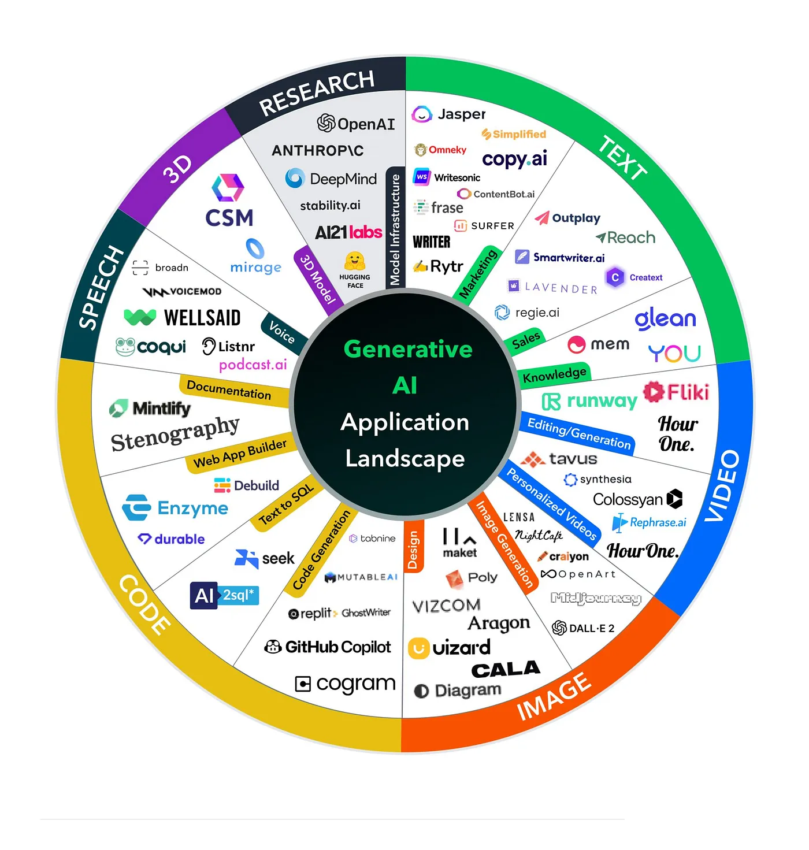

Slide 16












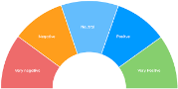


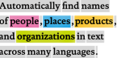
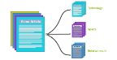
Traditional model development
High cost and slow deployment—each service is trained disjointly
DEPLOYMENTS
Tagging Services
Spatial Analysis Services
Accessibility Services
Spatial Presenter
Azure Search, Video Indexer
EAGLE
EAGLE
FLOWER
PLAYING SOCCER
Classification
Object Detection
Object Tracking
Action Recognition
Entities
Topics
Sentiments
TASKS
Classification Model
Detection Model
Tracking Model
Action Model
Entity Recognition
Topic Classification
Sentiment Analysis
INDIVIDUAL MODEL (DISJOINTLY)
TRAINING DATA (w/ ANNOTATION)
Tagging | Detection | Tracking | Action | Entity | Topic | Sentiment
data | data | data | data | data | data | data

Slide 17
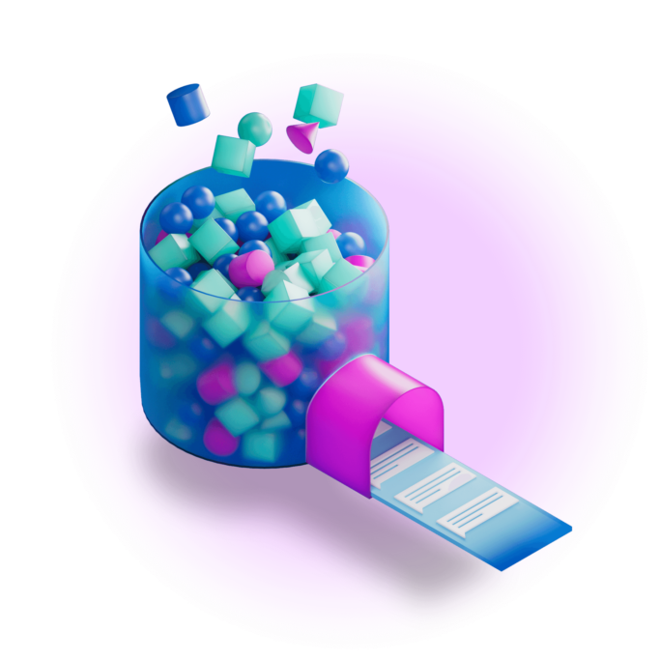
10 AI terms everyone should know
Machine learning: A field of computer science where people teach a computer system how to do something by training it to identify patterns and make predictions based on data
Generative AI: A type of AI that can make new things, not just provide information about existing things4. It can create things like pictures, music, text, videos and code.
Large language models: Computing systems that use machine learning techniques to process language and mimic the way humans communicate. They can do things like translate languages, answer questions, summarize text, and write stories.
Responsible AI: A set of principles and practices that guide people as they try to design AI systems that are safe and fair for everyone6. It involves understanding the data that was used to train the systems and finding ways to mitigate any biases or harms.
Notes:
https://news.microsoft.com/10-ai-terms/

Slide 18
10 AI terms everyone should know
Generative Pre-trained Transformer (GPT)
Generative: Generates new content
Pre-Trained: Trained on data before fine-tuning
Transformer: Understands relationships b/w words
"Few-shot" learning
Reinforcement Learning from Human Feedback (RLHF
Notes:
https://news.microsoft.com/10-ai-terms/

Slide 19
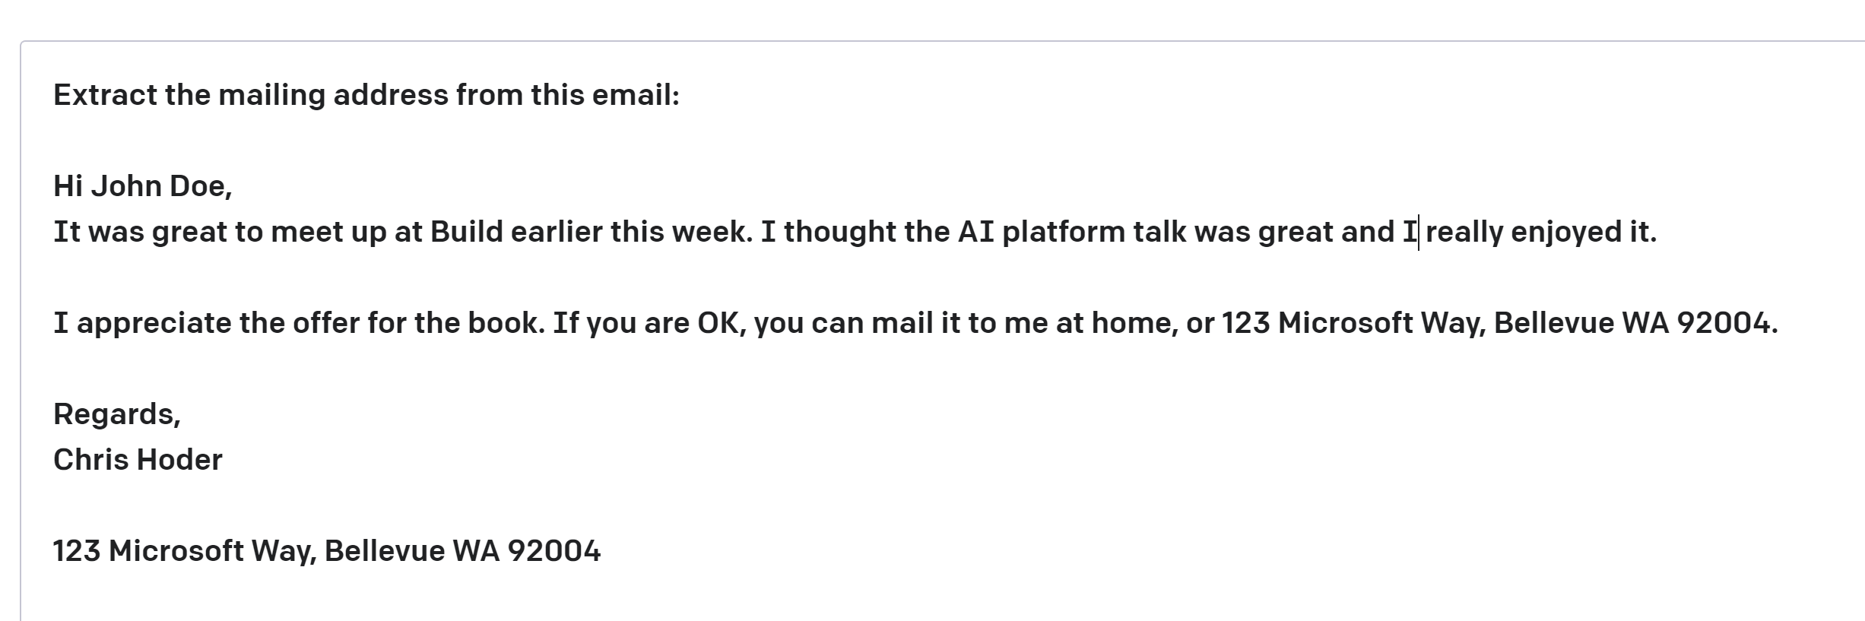
10 AI terms everyone should know
some context
Prompt—Text input that provides some context to the engine on what is expecting.
Completion—Output that the model generates based on the prompt.
Token — partial or full words processed and produced by the GPT models
Notes:
https://news.microsoft.com/10-ai-terms/

Slide 20
10 AI terms everyone should know
Hallucinations: When an AI model generates incorrect information but presents it as if it were a fact. This can happen due to insufficient, outdated, or low-quality training data, overfitting, use of idioms or slang expressions, or adversarial attacks.
OpenAI: A research organization that aims to create and promote artificial intelligence that can benefit humanity, without being constrained by profit or corporate agendas. It is backed by Microsoft and other prominent tech companies and individuals.
GPT: A series of large language models developed by OpenAI that use deep neural networks to generate natural language texts. The latest version, GPT-4, has 175 billion parameters and can perform various natural language tasks, such as answering questions, writing essays, and creating code.
ChatGPT: A popular AI chatbot that runs on the GPT-3.5 model and can generate decent-quality content from a simple prompt given by the user. It has a simple user interface and some guardrails to prevent AI hallucinations and harmful outputs1.
Gemini: A rebranded version of Bard, a multimodal AI tool that can work with different types of data, such as text, images, and audio. It is integrated with the Google ecosystem and can help users with various tasks, such as creating presentations, editing videos, and composing music.
Copilot: A rebranded version of Bing Chat, an AI assistant that runs on the GPT-4 model and can help users with information, questions, and conversation. It is integrated with the Microsoft Edge browser and can also generate imaginative and innovative content, such as poems, stories, code, and songs1.
Plugins: Software components that can extend the functionality of an AI model or tool. They can help users customize their experience, access different features, or interact with other programs. They can also help developers fine-tune or improve their AI models.
AI Model: A mathematical representation of a real-world process or phenomenon that is created by an AI system using data and algorithms. An AI model can learn from data and make predictions or decisions based on it. An AI model can be trained, tested, evaluated, and deployed.
Notes:
https://news.microsoft.com/10-ai-terms/

Slide 21
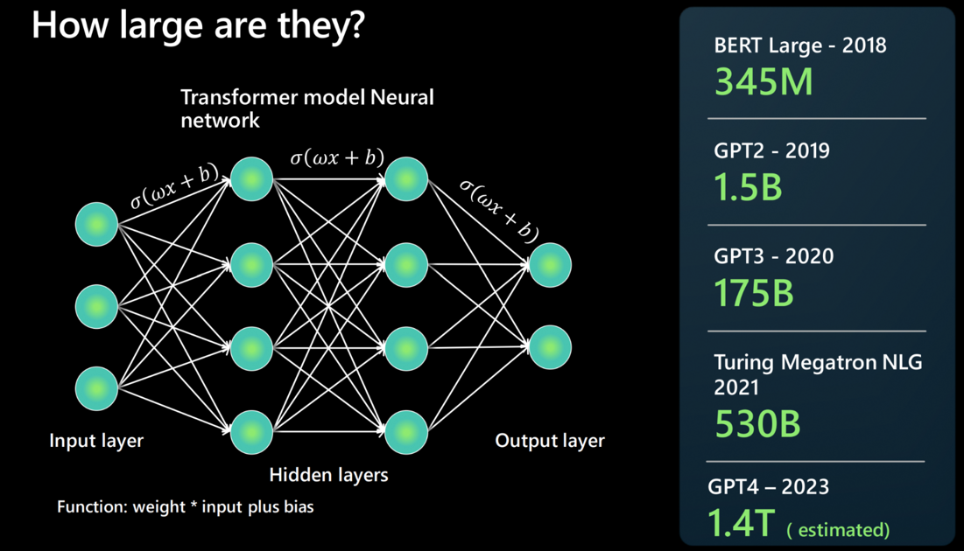
What are large language models?
Large Language Models (i.e., “language calculators”)
Large: More data than can be manually labeled
Language: Match context and words (e.g., word prediction, creative writing)
Model: Semi-supervised learning
A large language model (LLM) is a type of AI that can process and produce natural language text. It learns from a massive amount of data gathered from sources like books, articles, webpages, and images to discover patterns and rules of language.

Slide 22









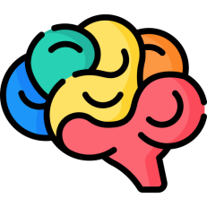









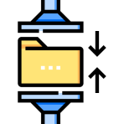





















Foundation Models
Tasks
Question and Answering
Data
Sentiment Analysis
Text
Images
Information Extraction
Speech
Training
Foundation Model
Adaptation
Structured Data
Image Captioning
3d Signals
Transformer Model
Object Recognition
Instruction Follow

Slide 23













Large Language Foundation models
Microsoft AI at Scale
Our mission is to expand the boundaries of natural language understanding.
machine reading comprehension, question answering, transfer learning, reinforcement learning, computer vision, and even building interpretable models
Turing-NLG
Megatron NLG Turing
T-ULRv5
DeepSpeed
ZeRO

Slide 24
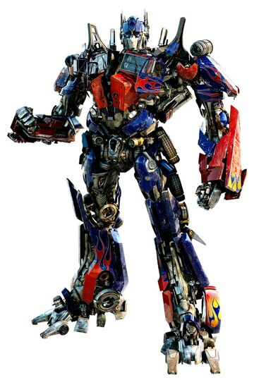
Transformers Models

Slide 25
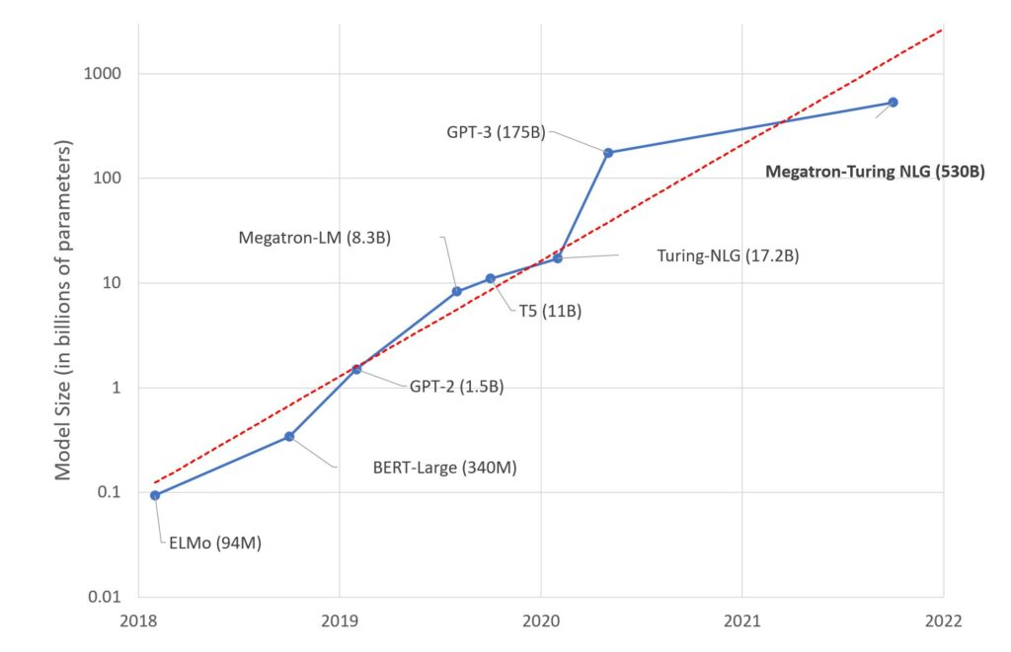
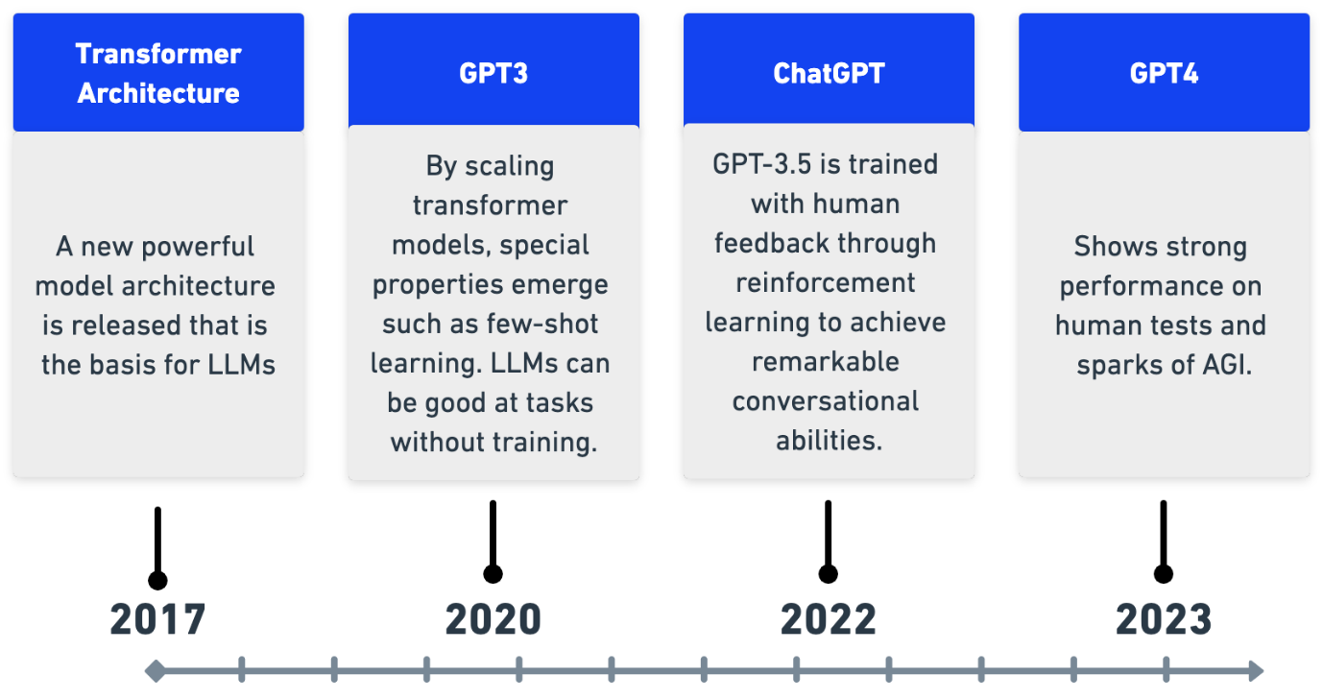
Model History and Size of LLM

Slide 26















Slide 27















Slide 28
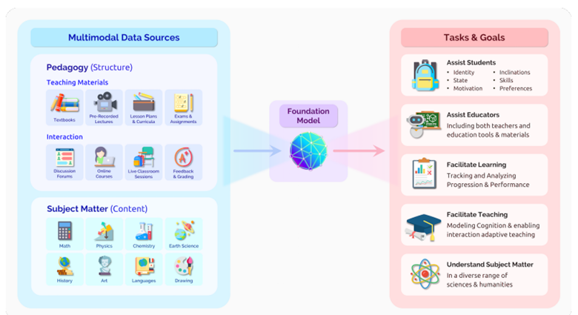

Slide 29
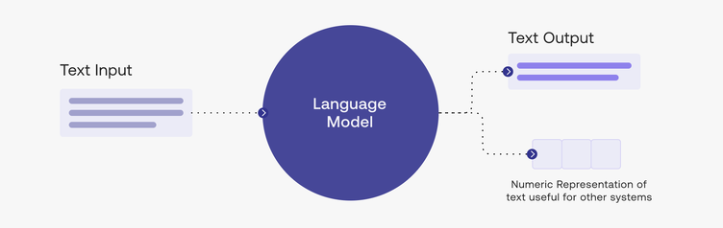
How to use LLM

Slide 30
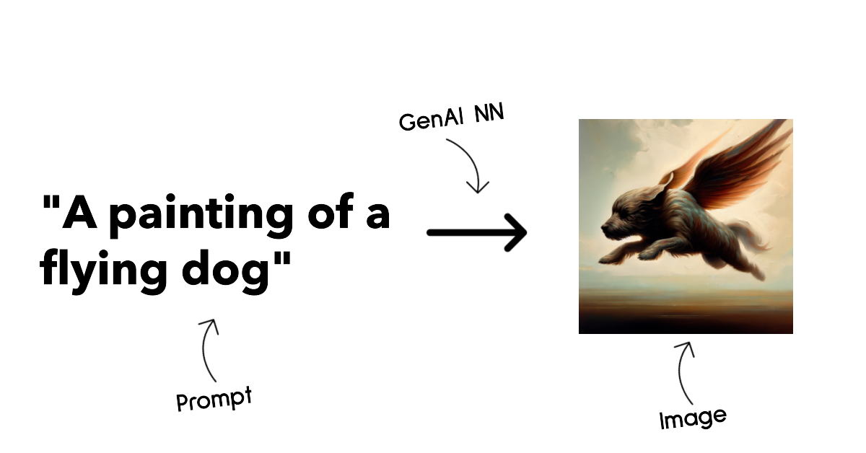

Slide 31
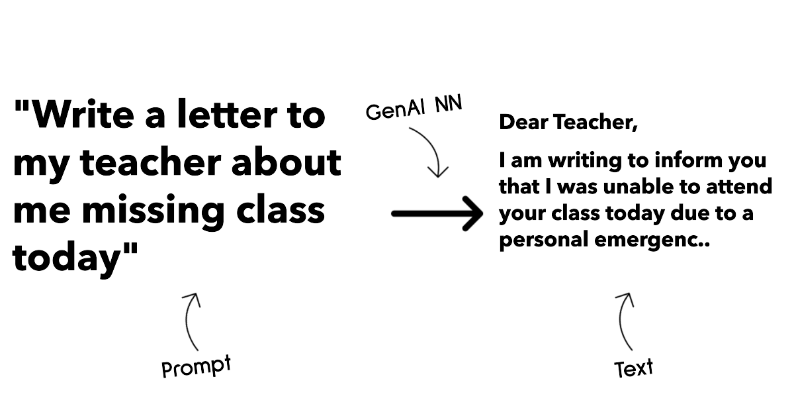

Slide 32
Generative AI in Azure
Open Source Models
MLOps with Azure AI Studio
Vector Search Option
Vector database
Azure APMI
Advance security and Networking
Fine Tuning ML infrastructure
And Open AI Models
Integration with other Azure components and copilot ecosystem

Slide 33

Introduction to OpenAI
What is OpenAI?
OpenAI is a private research laboratory that aims to develop and direct artificial intelligence (AI) in ways that benefit humanity as a whole. The company was founded by Elon Musk, Sam Altman and others in 2015 and is headquartered in San Francisco.

Slide 34
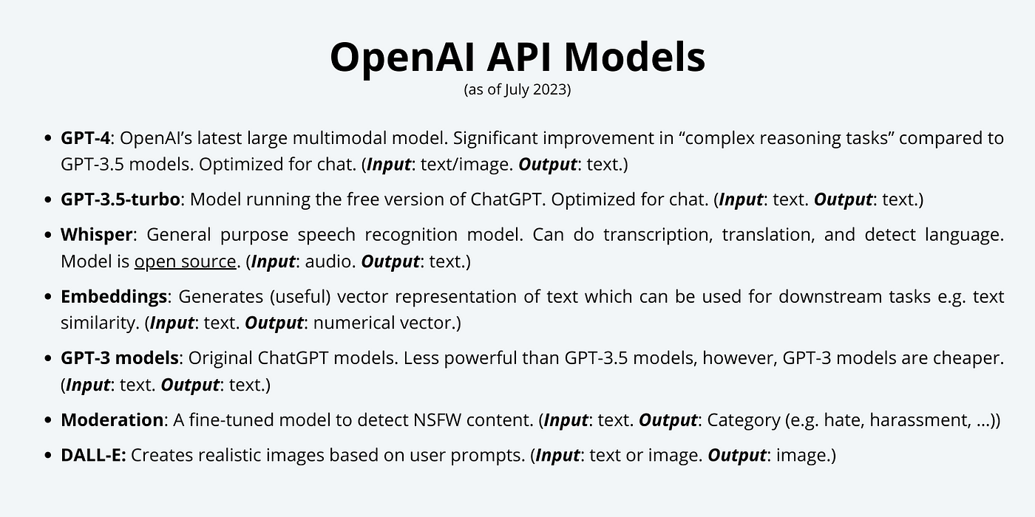

Slide 35
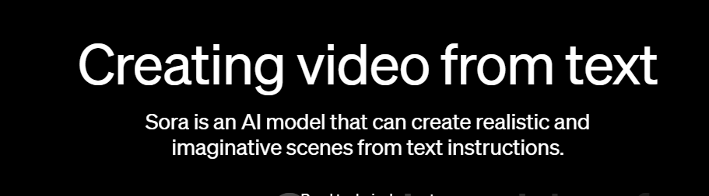
https://cdn.openai.com/sora/videos/tokyo-walk.mp4

Slide 36
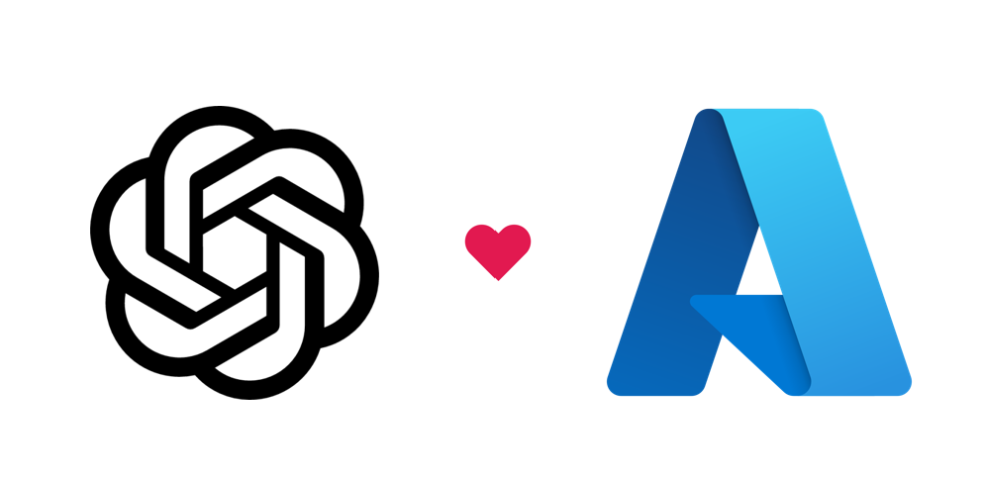
Introduction to Azure OpenAI?
Azure OpenAI Service is Microsoft's cloud solution for deploying, customizing, and hosting large language models. It brings together the best of OpenAI's cutting edge models and APIs with the security and scalability of the Azure cloud platform. Microsoft's partnership with OpenAI enables Azure OpenAI users to access the latest language model innovations.
Azure OpenAI supports many models that can serve different needs. These models include:
GPT-4 models are the latest generation of generative pretrained (GPT) models that can generate natural language and code completions based on natural language prompts.
GPT 3.5 models can generate natural language and code completions based on natural language prompts. In particular, GPT-35-turbo models are optimized for chat-based interactions and work well in most generative AI scenarios.
Embeddings models convert text into numeric vectors, and are useful in language analytics scenarios such as comparing text sources for similarities.
DALL-E models are used to generate images based on natural language prompts. Currently, DALL-E models are in preview. DALL-E models aren't listed in the Azure OpenAI Studio interface and don't need to be explicitly deployed.

Slide 37

GPT-3.5 and GPT-4
ChatGPT
Codex
DALL·E 2
Text
Conversation
Code
Images
Prompt
Write a tagline for an ice cream shop.
Prompt
I’m having trouble getting my Xbox to turn on.
Prompt
Table customers, columns = [CustomerId, FirstName, LastName, Company, Address, City, State, Country, PostalCode]
Create a SQL query for all customers in Texas named Jane
query =
Prompt
A ball of fire with vibrant colors to show the speed of innovation at our media and entertainment company
Response
There are a few things you can try to troubleshoot this issue … …
Response
We serve up smiles with every scoop!
Response
Prompt
Thanks! That worked. What games do you recommend for my 14-year-old?
Response
SELECT *
FROM customers
WHERE State = 'TX' AND FirstName = 'Jane'
Response
Here are a few games that you might consider: …
Notes:
GPT3 – GPT3.5 AND GPT 4 now - can understand and generate text. providing a prompt this model will generate an answer with natural language (image inputs coming in the future)
Codex – translates natural language to code, powers Github Co-Pilot, proficient in a dozen programming languages, a descendant of GPT3 model
DALLE – created original and realistic art from a text description
ChatGPT – interacts in a conversational way, conversation allows for follow up questions that hold context

Slide 38
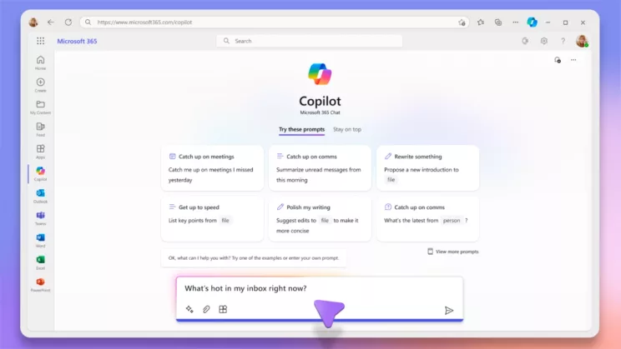
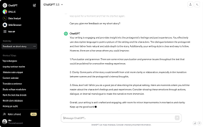
Microsoft Product based on Azure OpenAI
Open Product based on OpenAI Model
GPTs and ChatGPT
Copilots

Slide 39
Access to OpenAI
Open-AI LLM
Cloud hosted API only
Azure hosted
OpenAI Hosted

Slide 40
Factors | Azure OpenAI | OpenAI
Ownership | A service provided by Microsoft Azure that co-develops the API's with OpenAI. | A research laboratory that develops and publishes new AI Models.
GPT-4 support | Supports the latest GPT-4 models, which are currently in preview. | Supports the GPT-4 models but you require ChatGPT plus subscription to access the models.
Security | Provides enterprise-grade security features such as encryption, authentication and role-based access control. | Provides basic security features such as API key and content filtering.
VNET and private endpoint support | Supports virtual network and private endpoint integration as part of Azure Cognitive Services. | Does not support virtual network and private endpoint integration
Access | Access is limited and requires an application process that evaluates the use cases and responsible AI principles | Access is open and requires a subscription plan that varies by model and usage
Learning Resources | Provides documentation, tutorials, examples, and best practices for using the service | Provides documentation, playgrounds, examples, and blog posts for using the service
Customer Support | Provides support options through Azure Cognitive Services support guide | Provides support options through OpenAI platform support guide
Fine-tuned Model creation | Allows fine-tuning of some models to customise them for specific tasks | Allows fine-tuning of some models to customise them for specific task
Pricing for ChatGPT | ChatGPT is not available in Azure OpenAI service | ChatGPT is available in OpenAI service with a subscription plan of $20 per month for ChatGPT Plus program
Prompt and completion for ChatGPT | ChatGPT is not available in Azure OpenAI service | ChatGPT is available in OpenAI service with a web-based interface that allows users to interact with the model by providing prompts and receiving completions
Model | Azure OpenAI Service | OpenAI API | Description
GPT-4 | YES | NO | A large multimodal model that can understand and generate natural language or code, and perform complex tasks with greater accuracy than any previous model.
GPT-3.5 | YES | YES | A set of models that improve on GPT-3 and can understand and generate natural language or code.
Codex | YES | YES | A model that can generate and execute code for a wide range of programming languages and tasks.
DALL-E | YES | YES | A model that can generate and edit images given a natural language prompt.
Whisper | YES | NO | A model that can convert audio into text.
Embeddings | YES | NO | A set of models that can convert text into a numerical form.
Moderation | YES | NO | A fine-tuned model that can detect whether text may be sensitive or unsafe.
GPT-3 | YES | YES | A set of models that can understand and generate natural language.
Facts

Slide 41




Azure OpenAI
Content generation
Call center analytics: automatically generate responses to customer inquiries
Summarization
Code generation
Semantic search
Call center analytics: summary of customer support conversation logs
Subject matter expert document: summarization (e.g. Financial reporting, analyst articles)
Convert natural language to SQL (or vice versa) for telemetry data
Search reviews for a specific product/service
Generate personalized UI for your website
Convert natural language to query proprietary data models
Information discovery and knowledge mining
Social media trends
summarization
Code documentation
End to end call center analytics: classification, sentiment, entity extraction, summarization and email generation
Customer 360: hyper-personalisation using timely summarization of customer queries & trends, search, and content generation
Business process automation: search through structured & unstructured documentation, generate code to query data models, content generation

Slide 42

Security – AAD RBAC
Security – secure access via Microsoft private network
Latency - DC location
Privacy/compliance – opt out from data being stored
Privacy/compliance – Azure compliance certifications
Monitoring – integrates with Azure Monitor
Harmful content filtering

Slide 43
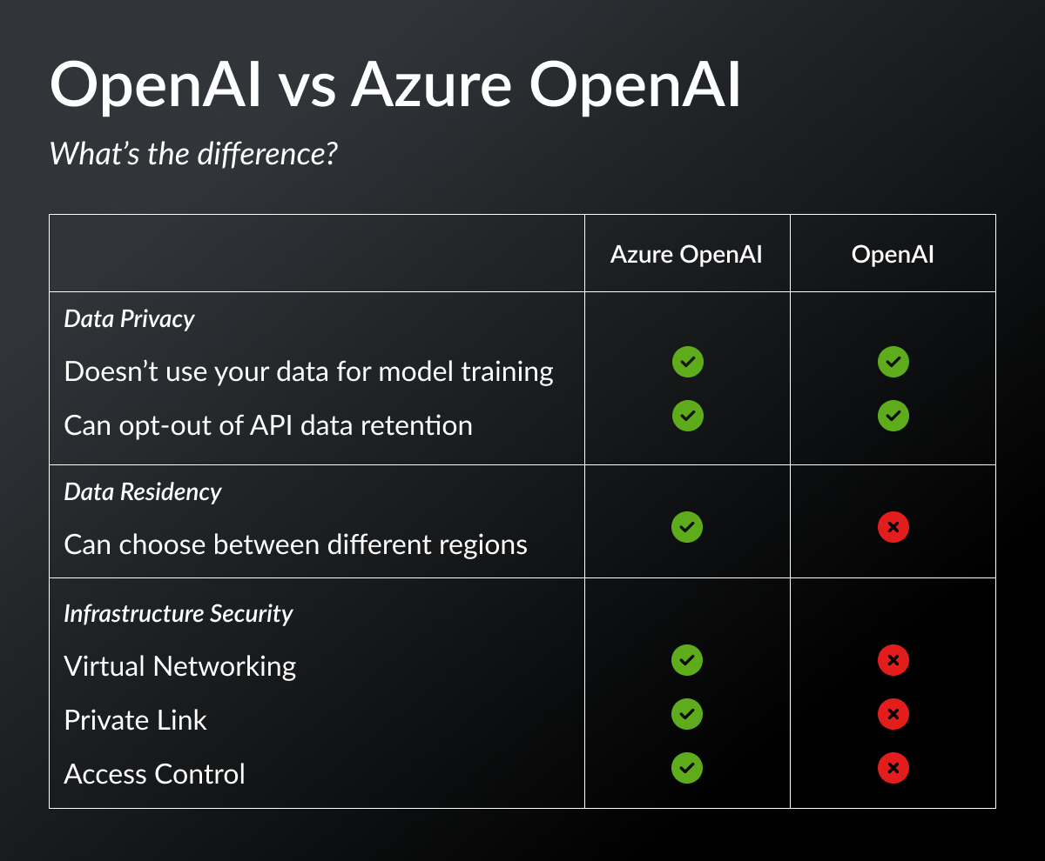

Slide 44
Security – AAD RBAC
Security – secure access via Microsoft private network
Latency - DC location
Privacy/compliance – opt out from data being stored
Privacy/compliance – Azure compliance certifications
Monitoring – integrates with Azure Monitor
Harmful content filtering

Slide 45


Generative AI
GPT-4
DALL·E
ChatGPT
Prompt:
Prompt: A white Siamese cat
What is the fastest animal on land?
Write a tagline for an ice cream shop.
Response:
the cheetah (Acinonyx jubatus), which can reach speeds of up to 60 miles (97 kilometers) per hour.
Response:
We serve up smiles with
What makes them so fast?
every scoop!
Cheetahs are built for speed and have several adaptations that make them the fastest land animal: lean body, long legs, flexible spine, large nostrils and claws that don’t retract.

Slide 46


GPT-3.5
Large, pretrained Language Models that use deep learning to generate content
Use cases:
Generating natural language for chatbots and virtual assistants with awareness of the previous history of chat
Power chatbots that can handle customer inquiries, provide assistance, and converse but
doesn’t have memory of conversations
Automatically summarize lengthy texts
Assist writers by suggesting synonyms, correcting grammar and spelling errors, and even generating entire sentences or paragraphs
Help researchers by quickly processing large amounts of data and generating insights, summaries, and visualizations to aid in analysis
Generate good quality code based on natural language
Use cases:
ChatGPT
Customize generation by adding your data as context to the AI model
GPT-4 () Built-in responsible AI to detect and mitigate
harmful use
Generating natural language for chatbots and virtual assistants that has memory of the previous history of chat
Improving the accuracy and efficiency of automated customer service interactions
Enhancing language translation software for more accurate and natural translations
Generating more human-like content for social media and marketing campaigns
Improving the effectiveness of natural language processing for tasks such as sentiment analysis and text classification
Use cases:
Generating and understanding natural language for customer service interactions, chatbots, and virtual assistants – doesn’t have memory of conversations
Generating high-quality code for programming languages based on natural language input.
Providing accurate translations between languages
Improving text summarization and content generation
Provides for multi-modal interaction (text and images)
Substantial reduction in Hallucinations
Consistency between different runs is high

Slide 47



Azure OpenAI |
Prompt—Text input that provides some context to the engine on what is expecting.
Completion—Output that GPT-3 generates based on the prompt.

Slide 48
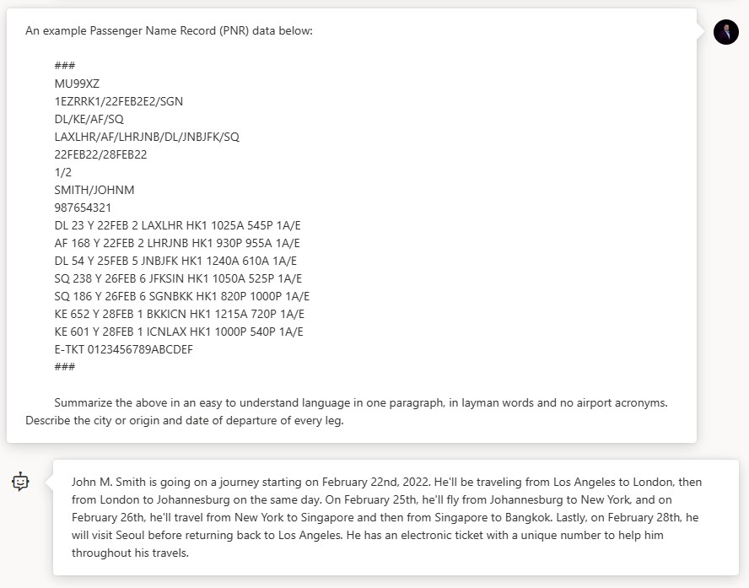

Aviation Example

Slide 49
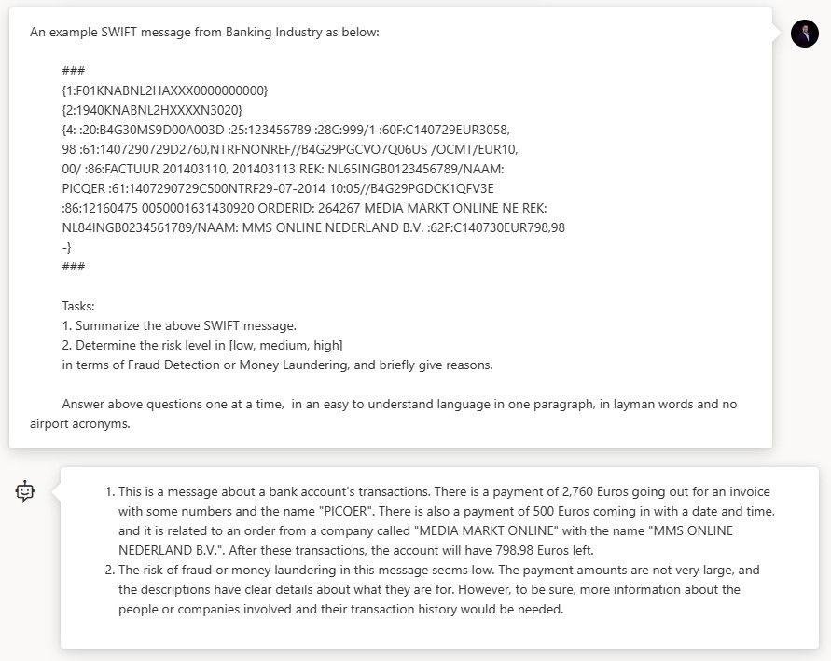

Finance Example

Slide 50
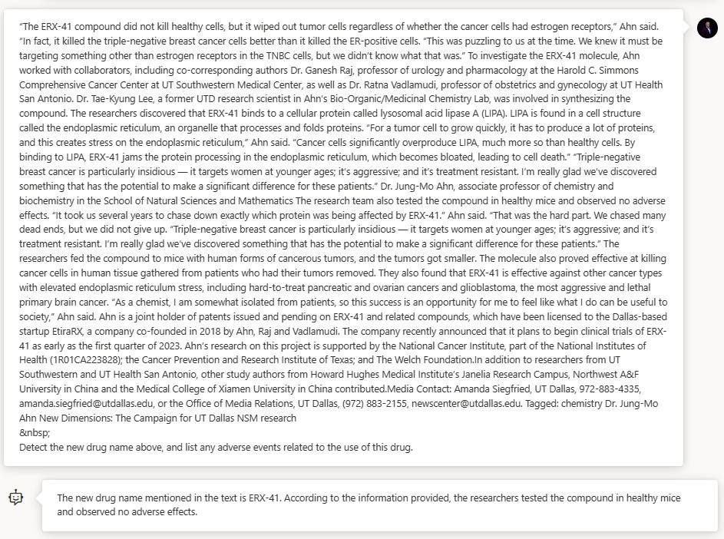
Biomedical Example

Slide 51



Previous GPT-3 models
The ChatGPT model
The ChatGPT model is conversation-in and message-out.
(i.e., it expects a prompt string that is formatted in a specific chat- like transcript format and returns a completion that represents a model-written message in the chat)
Previous models were text-in and text-out
(i.e., they accepted a prompt string and returned a completion to
append to the prompt).
Answer questions from the context below.
Context:
A neutron star is the collapsed core of a massive supergiant star, which had a total mass of between 10 and 25 solar masses, possibly more if the star was especially metal-rich.
Q: What is a neutron star? A:
[System Message]
Assistant is an AI Chatbot designed to answer questions from the context provided below.
Context:
A neutron star is the collapsed core of a massive supergiant star, which had a total mass of between 10 and 25 solar masses, possibly more if the star was especially metal-rich.
[User]
What is a neutron star?
[Assistant]

Slide 52
Chat Completion API
There are two different APIs available for working with the ChatGPT model.
Completion API
The ChatGPT model also works with the existing completions API. In this API, you’ll format your prompt as a string and need to use the special tokens from Chat Markup Language.
We generally recommend using the Chat API instead because the special tokens may get updated in future version of gpt-35-turbo meaning you would need to update your prompts before updating to newer versions of the model.
<|im_start|>system
Assistant is a large language model trained by OpenAI.
<|im_end|>
<|im_start|>user
What is a garbanzo bean?
<|im_end|>
<|im_start|>assistant
(Recommended)
A new API designed for working with Chat models (gpt-35-turbo and gpt-4). We recommend using this API moving forward.
In this API, you pass in a series of messages rather than the prompt as a raw string making it easier to manage the conversation.
messages = [
{
“role”: “system”,
“content”: “Assistant is a large language model trained by OpenAI.”
},
{
“role”: “user”,
“content”: “What is a garbanzo bean?”
}
]

Slide 53

Conversational
The conversational nature of the model makes it easier to interact with so you can more easily get the most out of the model.
Multi-turn
The conversational nature of ChatGPT makes it easy to follow up on the model’s response. This
gives users an easy mechanism to ask suggest edits, ask for clarification, etc.
Creative
The ChatGPT model excels at creative tasks like content writing and storytelling.

Slide 54
















LLM Workflow
User Question
Query My Data
Add Results to Prompt
Query Model Send Results

Slide 55













Slide 56











Microsoft Board
Executive Leadership
Office of Responsible AI
Our ecosystem
Research
Policy
Engineering

Slide 57








Principles
Goals
Requirements
Tools and Practices

Slide 58






Accountability
Transparency
Fairness
Reliability & Safety
A1: Impact Assessment
A2: Oversight of significant adverse impacts
A3: Fit for purpose
A4: Data governance and
management
A5: Human oversight and control
T1: System intelligibility for decision making
T2: Communication to
stakeholders
T3: Disclosure of AI interaction
F1: Quality of service
F2: Allocation of resources and opportunities
F3: Minimization of stereotyping, demeaning, and erasing outputs
RS1: Reliability and safety guidance
RS2: Failures and
remediations
RS3: Ongoing monitoring, feedback, and evaluation
Privacy & Security
Inclusiveness
PS1: Privacy Standard compliance PS2: Security Policy compliance
I1: Accessibility Standards compliance

Slide 59
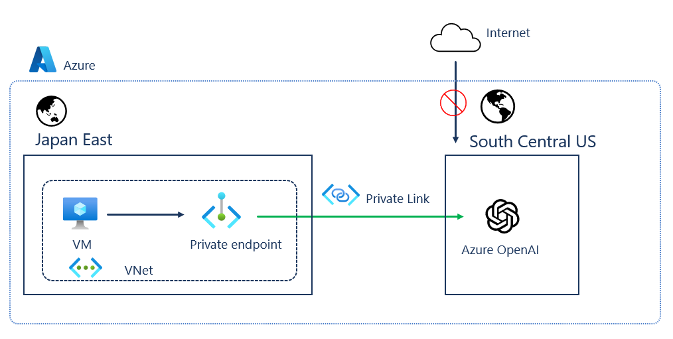

Slide 60



Content generation | Call Center Analytics: Automatically generate responses to customer inquiries
Code generation | Aircraft company using to convert natural language to SQL for aircraft telemetry data Consulting service using Azure OpenAI Service to convert natural language to query propriety data models
Semantic search | Financial services firm using Azure OpenAI Service to improve search capabilities and the conversational quality of a customer’s Bot experience. Insurance companies extract information from volumes of unstructured data to automate claim handling processes
Summarization | International insurance company using Azure OpenAI Service to provide summaries of call center customer support conversation logs Global bank using Azure OpenAI Service to summarize financial reporting and analyst articles Government agency using Azure OpenAI Service to extract and summarize key information from their extensive library of rural development reports Financial services using Azure OpenAI Service to summarize financial reporting for peer risk analysis and customer conversation summarization

Slide 61
End-to-end
call center analytics
Customer 360
Business process automation
Search through structured & unstructured documentation
Generate Code to query data models
Content Generation
Classification
Sentiment
Entity extraction summarization
Email generation
Hyper-personalisation using timely Summarization of customer queries & trends
Search
Content generation

Slide 62




Use cases
Codex
Natural Language to Code
Natural Language to SQL
Code to Natural Language
Code documentation
Refactoring
DALL·E 2
Creative ideation
Podcast and music playlist images
Content syndication
Marketing campaign personalization
Hyper-personalization

Slide 63



Language
Reason over structured and unstructured data: Classification, Sentiment, Entity Extraction, Search
Product feedback sentiment
Customer and employee feedback classification
Claims and risk analyses
Support emails and call transcripts
Social media trends
Writing assistance
Marketing copy/email taglines
Long format text
Paragraphs from bullets
Use cases

Slide 64
Language
Summarization
Call center call transcripts
Subject Matter Expert Documents
Competitive analysis
Peer Analysis
Technical reports
Product and service feedback
Social media trends
Conversational AI
Smart assists for call centers
Tech support chat bots
Virtual assistants
Use cases

Slide 65
Language
Use Cases that use multiple model capabilities
Contact Centers
Classification—route mails to appropriate
team
Sentiment—prioritize angry customers
Entity extraction and search—analyze liability and risk
Mail and call transcript summarization
Customer response email generation
Rapid response marketing campaigns: classification, sentiment, summarization, content generation, image generation
Use cases

Slide 66


This is only a REST API. It needs to be connected to applications and/or business processes to be useful.
These models use input from instructions and examples in the prompt to identify the task.
The model completes the task by predicting the most probable next text.
In the next section(s), we will cover three main approaches for in-context learning.
There are some additional considerations when choosing a use case. Learn more

Slide 67




Q&A
Ask the team anything
Usama Wahab Khan
Twitter : @usamawahabkhan
LinkedIn : Usamawahabkhan
Notes:
https://www.microsoft.com/en-us/ai/responsible-ai

